Slide 1
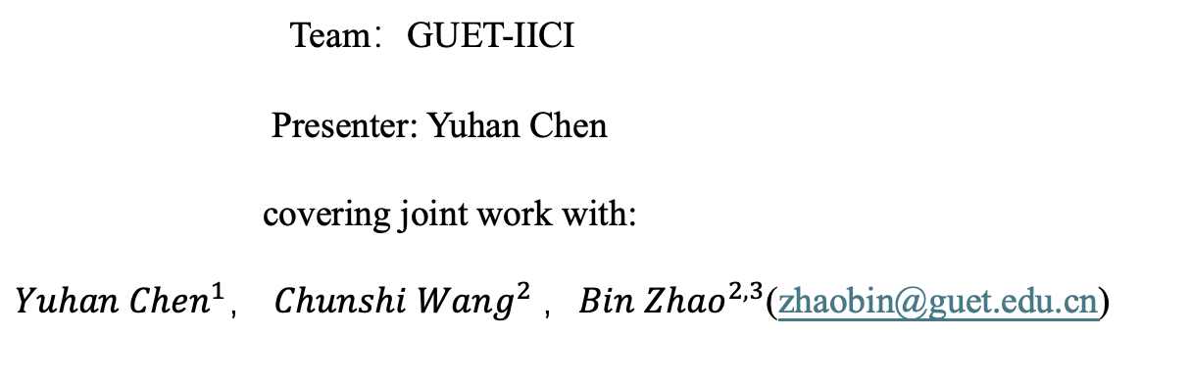
GUNLIN UNIVERSITY OF ELECTRONIC TECHNOLOGY
A Novel Two-Stage Approach for 3D Dental Tooth
Instance Segmentation
MICCAI 2024 Challenges : STS-3D
Team：GUET-IICI
Presenter: Yuhan Chen
covering joint work with:
${Yuhan Chen}^{1}$， ${Chunshi Wang}^{2}$，${Bin Zhao}^{2,3}$(zhaobin@guet.edu.cn)
$$^{1}School of Computer Science and Information Security, Guilin University of Electronic Technology,\text{Guilin}\text{, }\text{Guangxi}\text{, 541004, }\text{China}$$
$^{2}School of Artificial Intelligence, Guilin University of Electronic Technology$, Guilin, Guangxi, 541004, China
$$^{3}Guangxi Colleges and Universities Key Laboratory of AI Algorithm Engineering,\text{Guilin}\text{, }\text{Guangxi}\text{, 541004, }\text{China}$$

Slide 2
Outline
Introduction
Overview of framework
  Data process
  Creative use of binary segmentation as auxiliary information for instance segmentation.
  Using binary segmentation to extract the ROI of unlabeled data images and performing
  segmentation on the ROI.
  Based on the Unimatch network, introducing image-level perturbations and feature-level
  perturbations to better utilize unlabeled data for tooth segmentation.
Results
Acknowledgments

Slide 3
Introduction
generate panoramic images of the upper and lower jaws
Tooth images
extract edge maps of teeth to enhance image contrast at the shape boundaries
explore the combination of centroid and skeleton networks
[1] Tae Jun Jang, Kang Cheol Kim, Hyun Cheol Cho, and Jin Keun Seo. A fully automated method for 3d individual tooth identification and segmentation in dental cbct. IEEE transactions on pattern analysis
and machine intelligence, 44(10):65626568, 2021.
[2] Zhiming Cui, Changjian Li, and Wenping Wang. Toothnet: automatic tooth instance segmentation and identification from cone beam ct images. In Proceedings of the IEEE/CVF conference on computer
vision and pattern recognition, pages 6368–6377, 2019.
[3] Zhiming Cui, Yu Fang, Lanzhuju Mei, Bojun Zhang, Bo Yu, Jiameng Liu, Caiwen Jiang, Yuhang Sun, Lei Ma, Jiawei Huang, et al. A fully automatic ai system for tooth and alveolar bone segmentation
from cone-beam ct images. Nature communications, 13(1):2096, 2022.

Slide 4
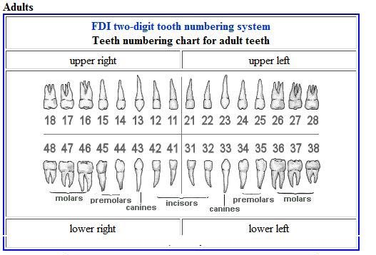
Introduction
Goal : Achieving instance segmentation of teeth based on FDI.
Dataset :
  Training set: 330 CBCT images, including 30 cases with labels and 300 unlabeled cases
  Validation set: 20 CBCT images
  Testing set: Number of CBCT images will be announced later

Slide 5
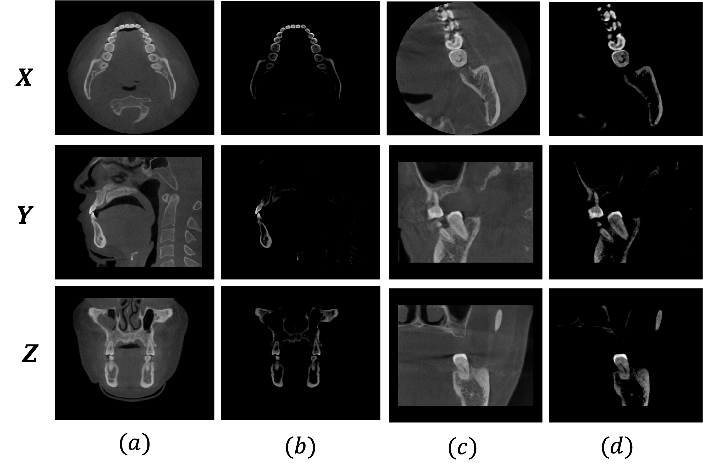
Data Process
The images after threshold processing(500-2500), from top to bottom, are the processed images of cross-sectional,
sagittal, and coronal views, respectively.

Slide 6
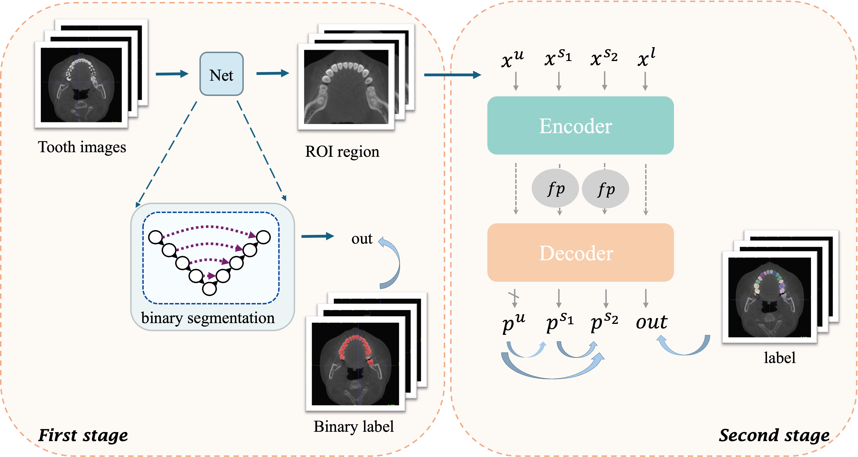
Framework

Slide 7
Framework
open_morphology
Using a semi-supervised net to extract the ROI.

Slide 8
Framework
  Based on the UNimatch network, introducing image-level perturbations and feature-level
  perturbations to better utilize unlabeled data for tooth segmentation.

Slide 9
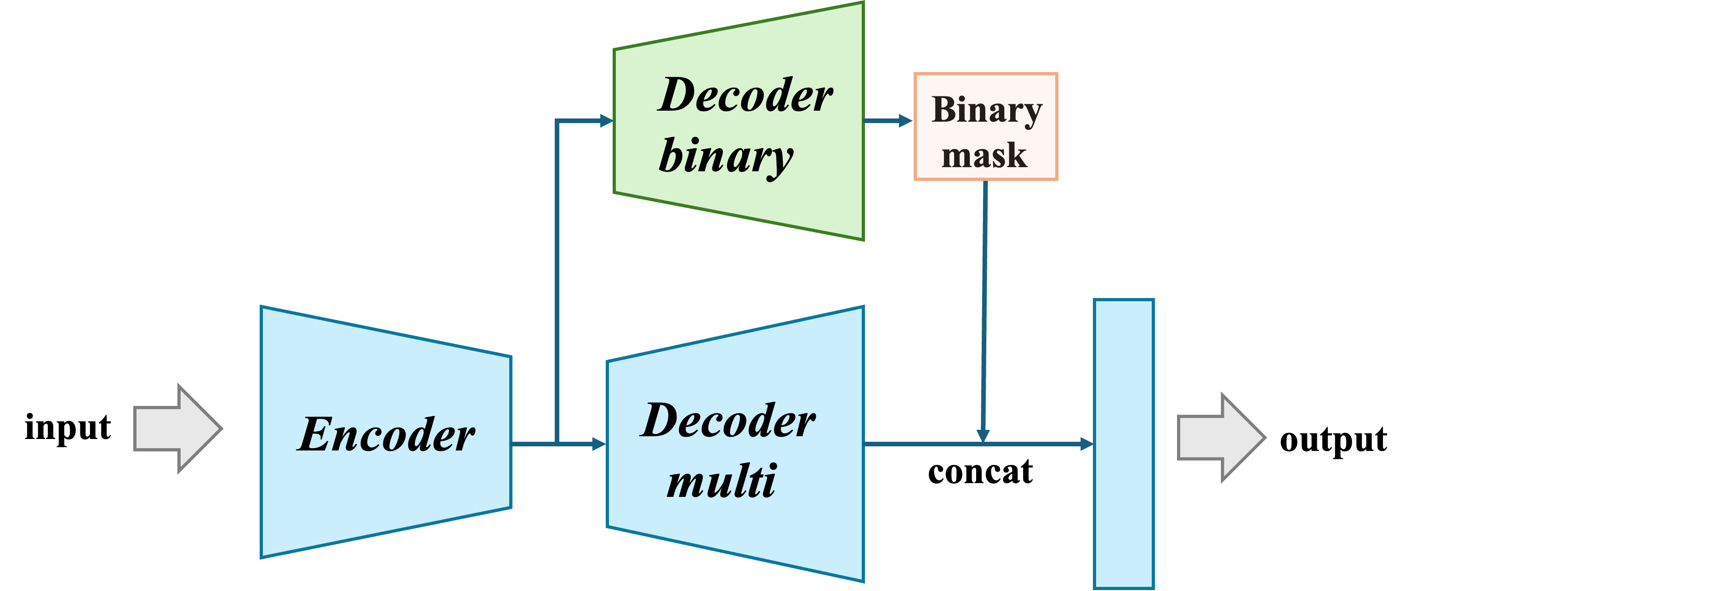
Framework
The segmentation decoder can perform more precise
classification guided by the contours of the teeth, thereby
enhancing the overall performance of the model.

Slide 10
Framework
  Creative use of binary segmentation as auxiliary information for instance segmentation.
  Using binary segmentation to extract the ROI of unlabeled data images and performing
  segmentation on the ROI to eliminate noise interference and avoid the impact of irrelevant areas
  Based on the Unimatch network, introducing image-level perturbations and feature-level perturbations to better utilize unlabeled data for tooth segmentation.

Slide 11
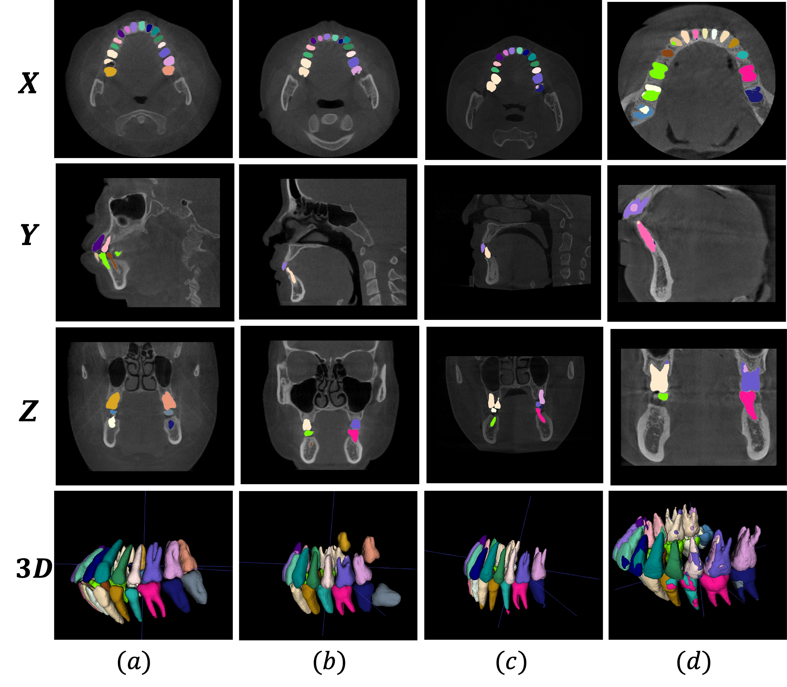
Results

Slide 12
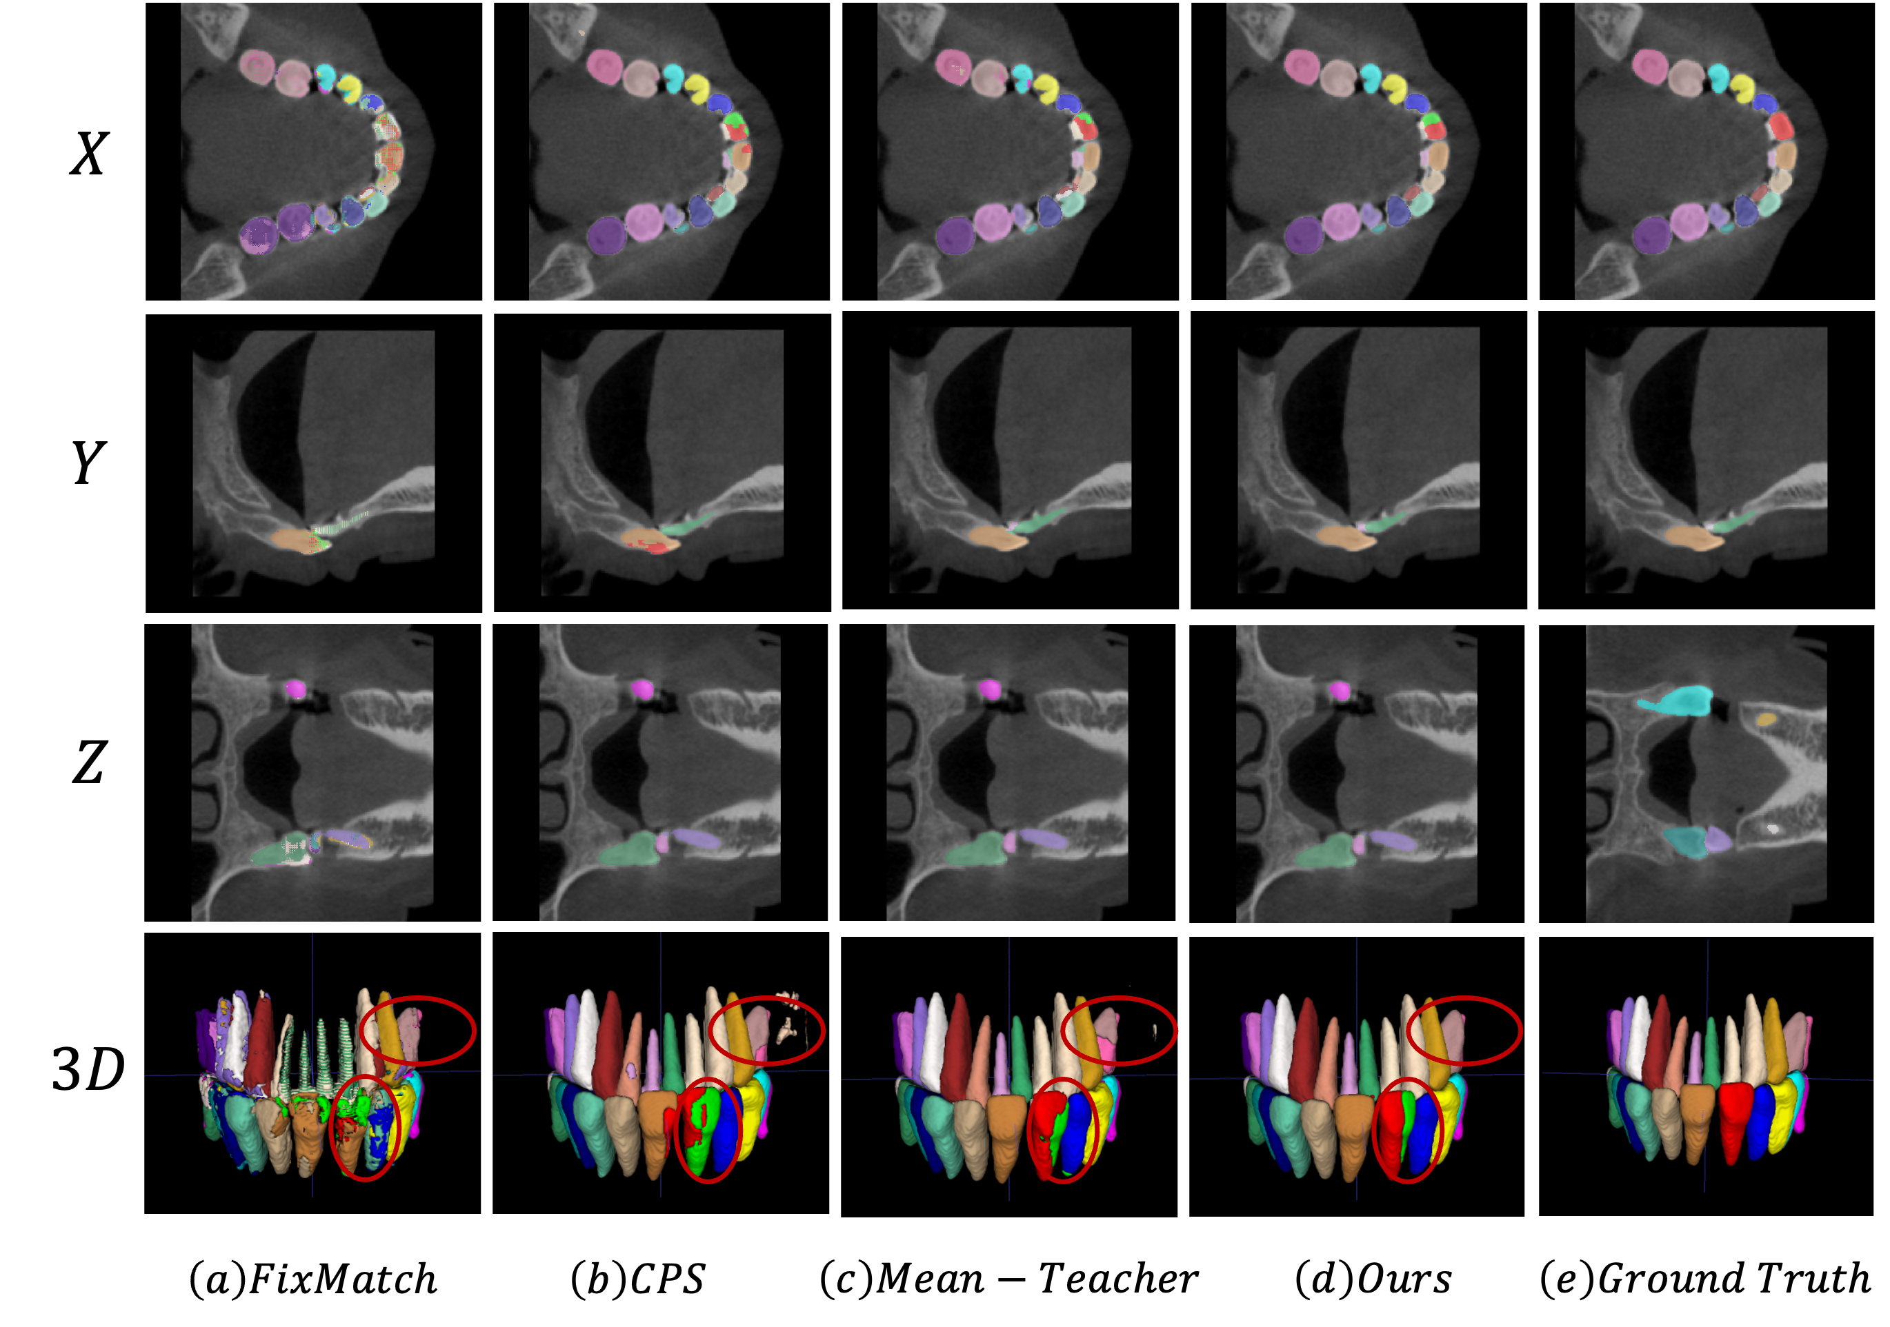
Results
Select 10% of the training set as the validation set.
Under the premise of extracting the ROI, we trained
various networks to obtain the following results.
Net | Score | Dice_A | Dice_B | NSD_A | NSD_B | mIoU_A | mIoU_B | IA
fixmatch | 56.60 | 38.67 | 90.64 | 30.19 | 97.31 | 29.20 | 83.10 | 27.08
CPS | 73.39 | 63.72 | 92.37 | 62.07 | 97.67 | 56.53 | 86.06 | 55.32
MT | 73.51 | 63.87 | 89.58 | 62.41 | 96.37 | 57.97 | 81.97 | 60.42
ours | 76.36 | 65.64 | 93.27 | 67.72 | 99.08 | 60.99 | 87.62 | 60.21
Table 1. Quantitative evaluation results of our method and comparison methods on the validation set.

Slide 13
Results
participate | Score | Dice_A | Dice_B | NSD_A | NSD_B | mIoU_A | mIoU_B | IA
Jichangkai | 93.7 | 90.5 | 96.7 | 92.8 | 99.1 | 87.9 | 93.9 | 95.0
houwentai | 92.2 | 89.1 | 95.2 | 91.6 | 97.8 | 85.1 | 91.0 | 95.7
ChohoTech | 92.0 | 88.3 | 95.0 | 92.0 | 98.6 | 84.1 | 90.4 | 95.4
Guet-IICI | 90.9 | 87.7 | 96.0 | 88.7 | 98.0 | 83.1 | 92.4 | 90.6
haoyuuuu | 90.0 | 85.6 | 95.9 | 87.2 | 97.3 | 82.2 | 92.1 | 90.4
Table 2.The top five results in the STS2024-3d competition on the validation set
A: instance level B: image level
Our method achieved fourth place in the validation set.

Slide 14








Acknowledgments

